Slide 1
3rd Pd. Agenda: 1. Turn-in Bill of Rights Project 2. Constitutional Convention and Principles of Constitution Notes 3.Answer reflection question in Journal—grade check next time

Slide 2
Constitutional Convention

Slide 3
May 25, 1787
Goal: revise & improve the Articles of Confederation
All but Rhode Island show up
55 delegates there

Slide 4
Important people:
George Washington
President of the Convention
Alexander Hamilton
delegate from NY
James Madison
“Father of the Constitution”

Slide 5
Realized they couldn’t improve the Articles, so they started from scratch
Arguments start between big and little states

Slide 6
The Virginia Plan
By James Madison
Called for a strong central govt
Legislative --> pass laws
Have two houses (bicameral), seats by population
Judicial --> decide if laws are carried out properly
Executive --> execute laws

Slide 7
The New Jersey Plan
Small states didn’t like the VA Plan b/c big states get more power
3 branches BUT the legislative branch have ONE house and ONE vote per state
Natl govt could tax and regulate trade

Slide 8
The Great Compromise
Argued with no end in sight
Roger Sherman form CT found a compromise (agreement)
Two-house legislature
Lower house - House of Representatives
by popular vote & state
population
Upper house - Senate
2 regardless of population

Slide 9
Arguments between N & S began
Three-Fifths Compromise
South wanted the slave population to count towards their numbers in H of Rep
North says no BUT want slave population to count for tax purposes
Compromise!!
3/5 of state slave population count for taxes and representation

Slide 11
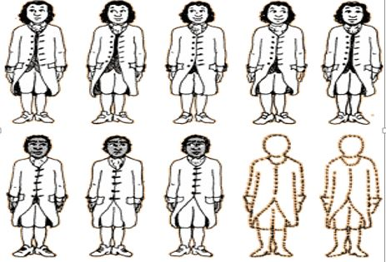

Slide 12
Slave Trade
By 1787, some N states ban slave trade within their borders - argues that S should too
S says it will ruin their economy
Compromise!!
N agreed that congress would not outlaw slavery for 20 years
after that, congress could regulate it
N agreed that no state could stop a fugitive slave from being returned to an owner who claimed him

Slide 13
Reflection Question-answer in Journal will be a grade check next class
Why is the issue of slavery referred to as “unfinished business” after the Constitutional Convention? Must support your answer

Slide 14
Ideas behind the Constitution
Magna Carta & English Bill of Rights
- Written declaration of citizen’s rights
Roman Republic
- representative govt
- Citizens involved in govt
Constitution
Enlightenment
Recognizes natural rights
Separation of powers (branches)
American Experience
Experience fighting for independence
Struggle to form a strong central govt

Slide 15
Why wasn’t the Bill of Rights originally in the US Constitution? By James Coll
Click on Image for Video

Slide 16
Principles of the Constitution

Slide 17
Federalism
division of power between the national government and the states

Slide 18
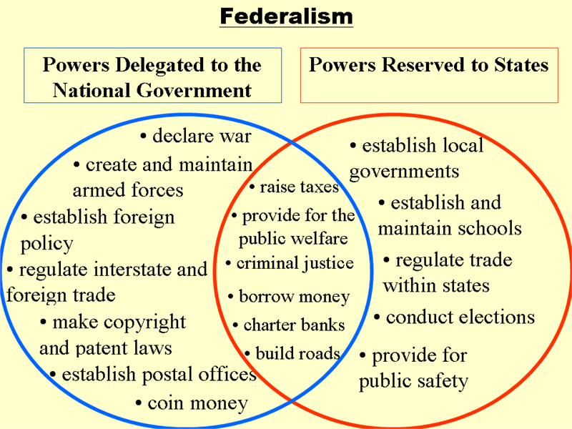
Federalism

Slide 19
Popular Sovereignty
the people have the power and use it by voting

Slide 20
Popular Sovereignty

Slide 21
Republicanism
the people elect representatives to work in government for them
Rep

Slide 22
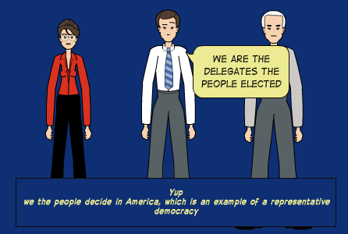
Republicanism

Slide 23
Separation of Powers
the power of the government is separated between the 3 branches:
Legislative: Makes laws
Executive: Enforces laws
Judicial: Interpret laws
Executive
Judicial

Slide 24
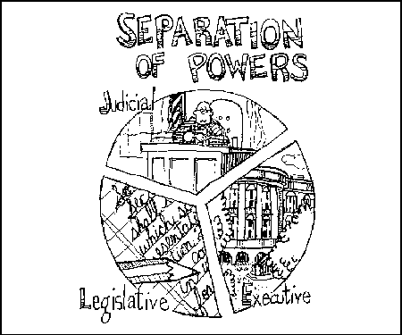
Separation of Powers

Slide 25
Checks and Balances
the branches of government have ways to keep the others in check
Executive
Judicial

Slide 26
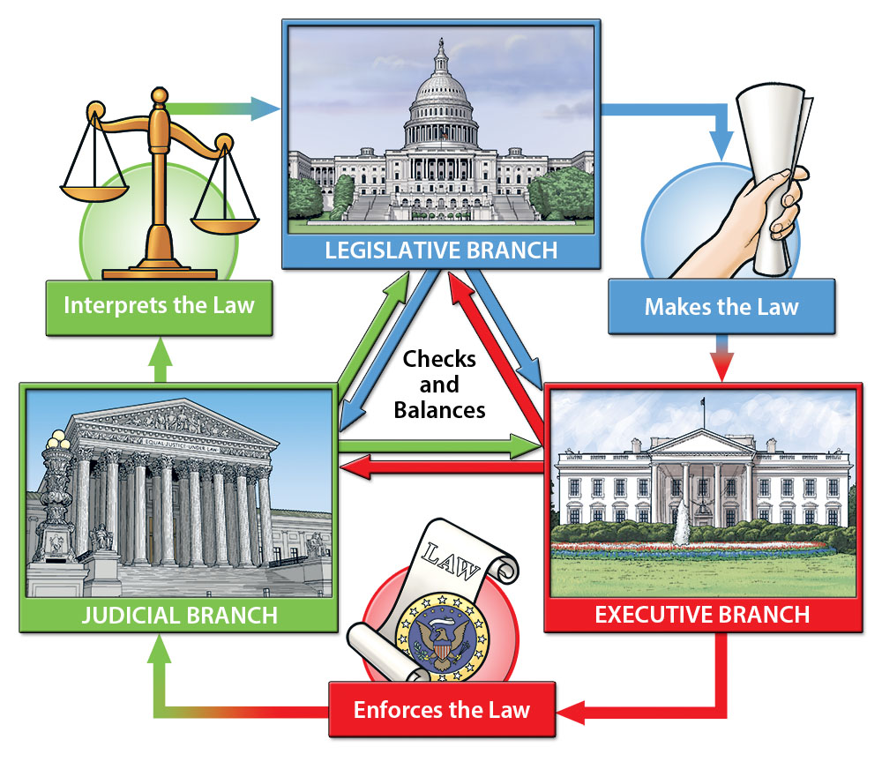
Checks and Balances

Slide 27
Limited Government
Constitution
there are limits to the power of government
Constitution
Executive
Judicial
Constitution

Slide 28
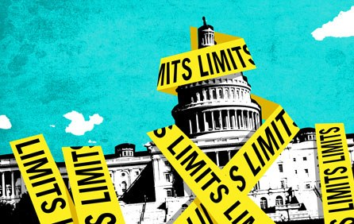
Limited Government

Slide 29
Individual Rights
the rights and freedoms protected by the first 10 amendments (Bill of Rights)
Bill of Rights

Slide 30
Individual Rights

Slide 31
Title your journal page Branches of Government. Copy the chart below into your journal.
Constitution
“Supreme law of the land.”
Legislative
(pass laws)
Executive
(enforce laws)
Judicial
(interpret laws)
House of Representatives
435, elected from states
based on population
Leader: Speaker of the House
President &
Vice-President
Supreme Court
9 judges
Cabinet
Federal & Appellate Courts
Senate
100, two from each state
Leader: Majority Leader

